Slide 1

Sentiment Analysis of COVID-19 Tweets

Slide 2
Agenda
Introduction
Technologies Used
Data Collection
About Data
Exploratory Data Analysis
Data Preprocessing
Modeling Process
Performance Evaluation
Results
Conclusion

Slide 3


Presenters
6

Slide 4
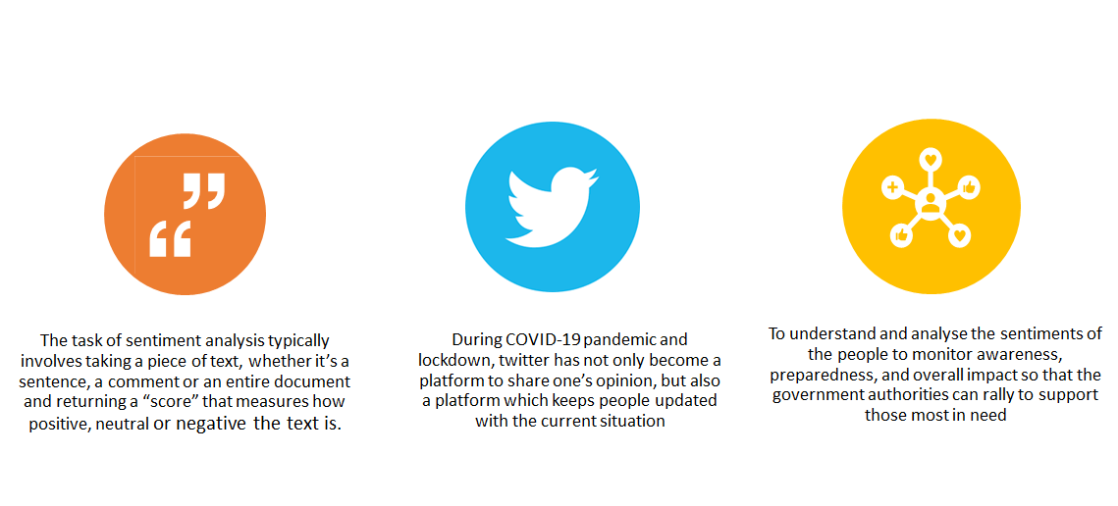
Introduction
Notes:
Looking at the beginning of the outbreak through the first day that the first person outside of China was diagnosed with the virus (January 1-13) there were 48.7K Tweets mentioning the coronavirus with 27% of those tweets expressing fear.

Slide 5
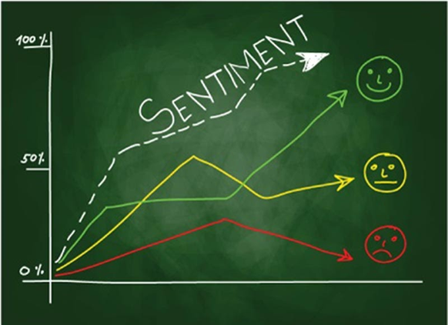
Extracted tweets from Twitter with hashtags ‘#coronavirus’, ‘#corona’ and ‘COVID-19’ in the months of March, April and May (first week)
Visualized tweets to show the trends in the sentiments
Calculated the tweet sentiment and measured the performance of the algorithms against time, scale and accuracy.

Slide 6



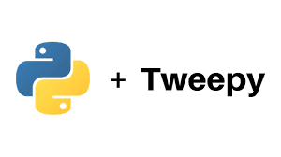


Technologies Used

Slide 7
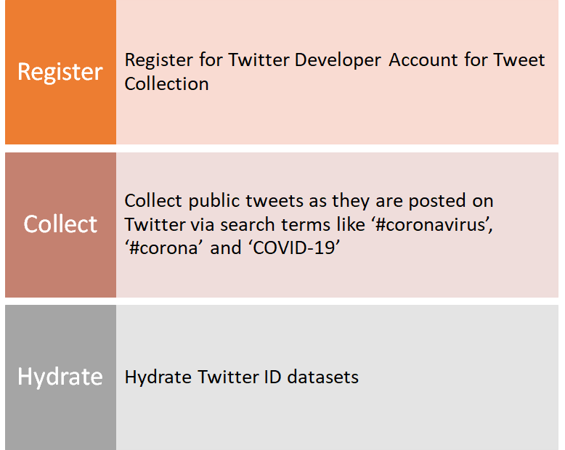
Data Collection

Slide 8
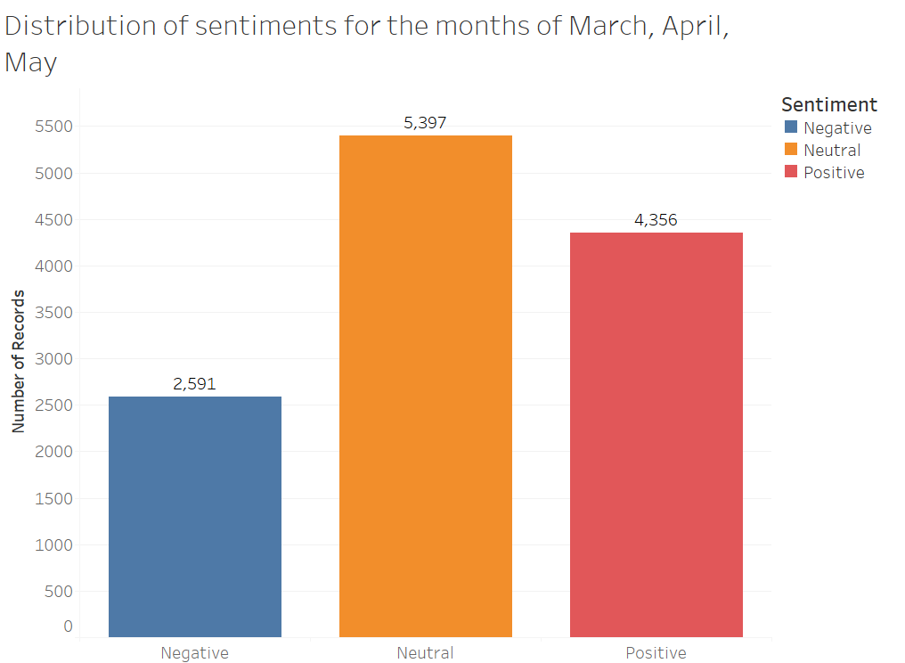
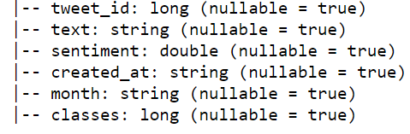
About Data
Number of rows= 12344
Number of columns= 6
Target Variable : classes
0 - Negative
1 - Neutral
2 - Positive

Slide 9
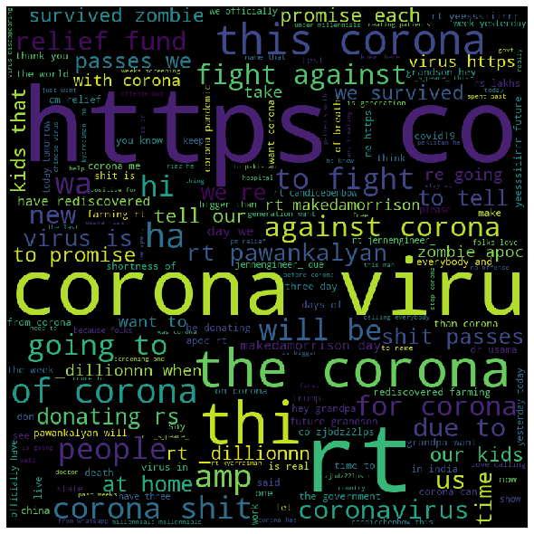
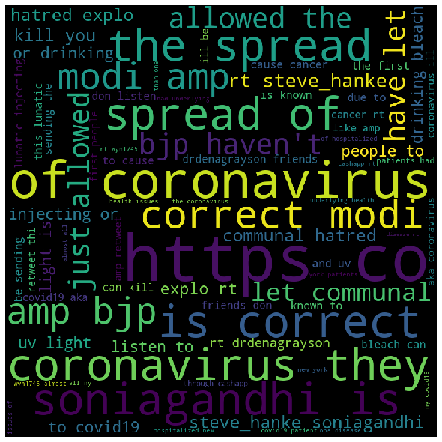
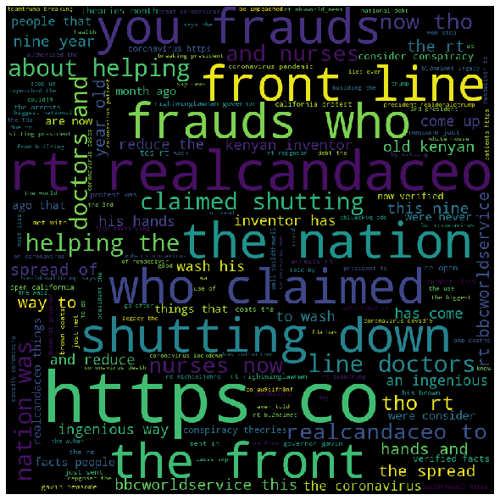
About Data
March
April
May

Slide 10
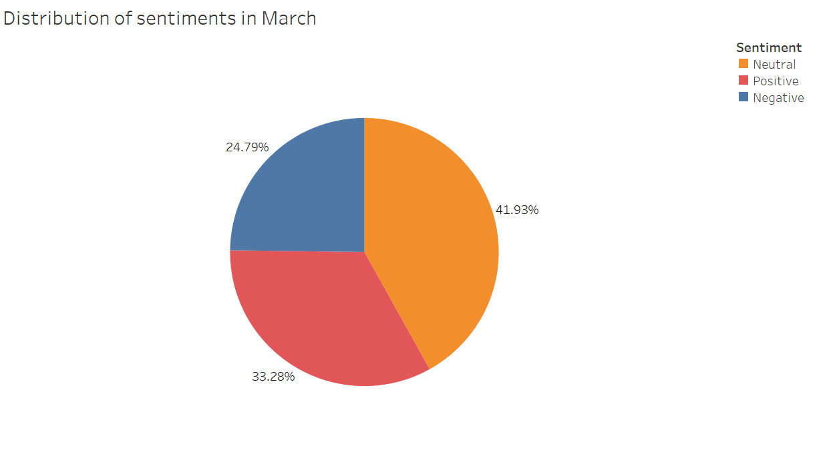

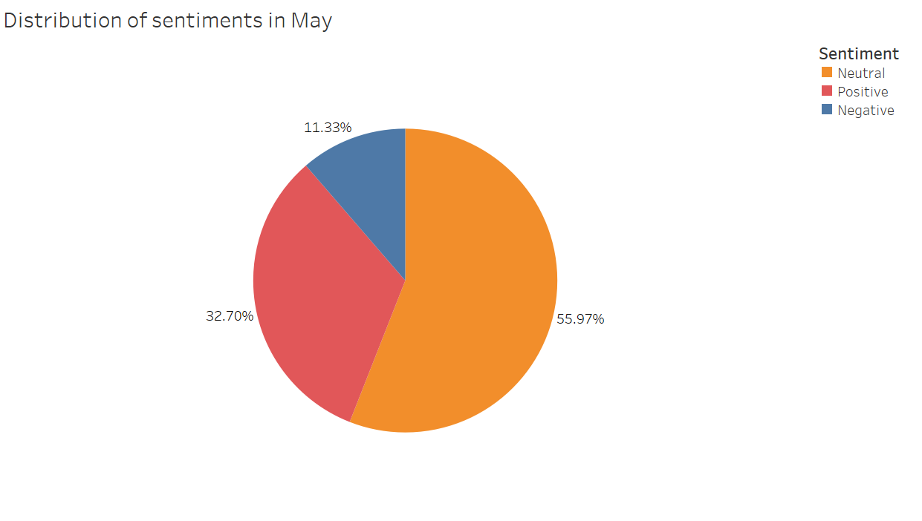
Exploratory Data Analysis
Neutral sentiment decreases in April and begins to rise as of first week of May
Negative sentiment decreases drastically in the first week of May whereas positive sentiment occupies about 30-33% of the total tweets across all three months.

Slide 11
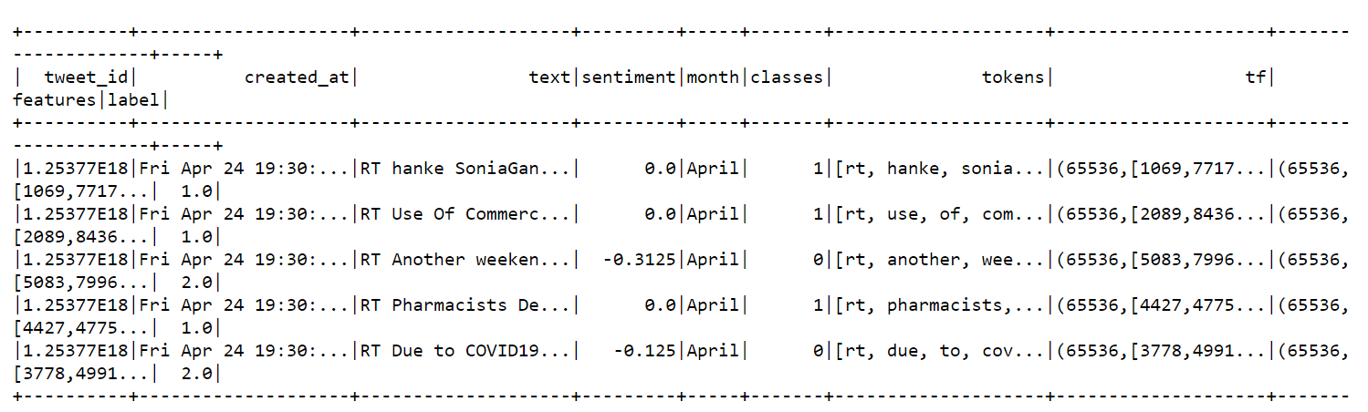
Data Preprocessing
Cleaned tweet text by removing links, special characters using regex
Converted the words in the text to numbers using TF-IDF Vectorizer
RT @DrDenaGrayson: Friends, donâ€™️t listen to this lunatic. Injecting or drinking bleach can KILL you, and UV light is known to cause cancer.â€¦
RT Friends don t listen to this lunatic Injecting or drinking bleach can KILL you and UV light is known to cause cancer

Slide 12
Modeling Process
Models used: Logistic Regression, Decision Trees, Random Forest
Launch a cluster on AWS EMR with instance = 3
Fetch data from AWS S3
Open a notebook
Split data into 30, 50, 70 and 90% of training and the rest as test data
Run a pyspark run model of all the above algorithms
Note down time taken to run and accuracies for each case
Terminate the cluster
Repeat the above steps with instance = 1 to compare local vs server performances

Slide 13
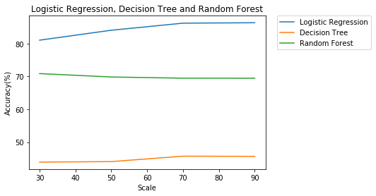
Performance Evaluation
Accuracy vs Scale for our Three Models:
Logistic > Random Forest > Decision Trees
Why?
The performance of Random Forest degrades when the number of features are less. Here the text of the tweet is our only feature!
Random Forests are an ensemble of weak decision trees. Hence together they perform better than just a single decision tree.

Slide 14
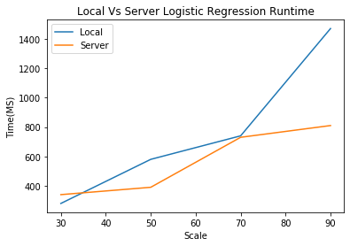
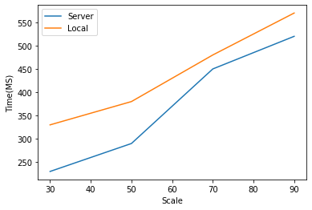
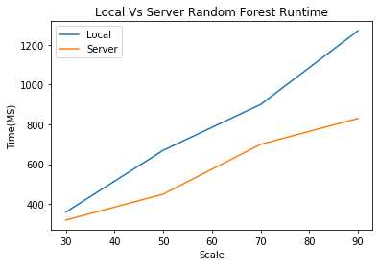
Performance Evaluation
Local vs Server time comparison:
X-axis - Scale, Y-axis - Time(ms)
Local Vs Server Decision Tree Runtime

Slide 15
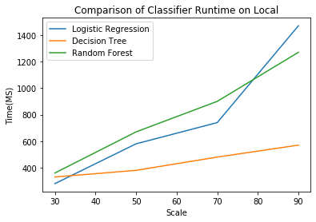
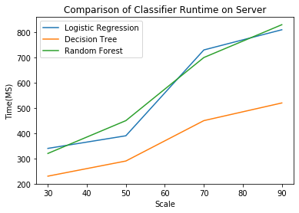
Performance Evaluation
Model time comparison:
X-axis - Scale, Y-axis - Time(ms)

Slide 16
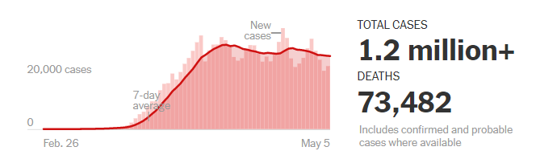
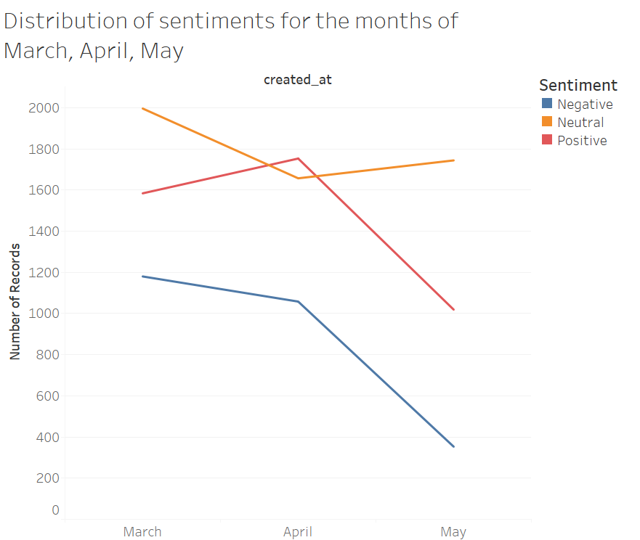
Results
Finally, we see the trend in the sentiments of the tweets for our 3 classes - negative, neutral and positive in comparison to the coronavirus cases per day map of the USA as of today

Slide 17
Conclusion
Sentiment Analysis of COVID-19 related tweets gave us an insight into the minds of people as we deal with this pandemic worsening, reaching the peak and going back into normal.
Logistic Regression gave us the highest accuracy of 86.18%
A comparison of local vs server performances were made and observed accurately that running parallel is faster
In conclusion, as this situation is getting better, people are starting to trust facts rather than negatively being impacted or wrongly believing in an “all is well” agenda. We see this clearly in the sentiments hidden in the tweets.

Slide 18
THANK YOU!

